Slide 1
MOVIE BOOKING MANAGEMENT SYSTEM
We intend to create a movie booking management system with administrator and customer access. The administrator account would allow to add/delete movies, change timings/venue of movie, view customer details as well as the seat allocations.
The customer account would allow one to view ticket price in all categories like platinum, gold, silver.
We used XAMPP software for this purpose.

Slide 2
Platforms used
Front-end - HTML , CSS
Back-end - MySQL (MySQLi)
Linking - PHP

Slide 3
Administrator account module
We intend to be able to perform the following actions with the administrator access :-
Sign-in/Sign-up
Add/remove shows
View all movies by date
View customer details (all account activity)
User can search for details of any movie as per his choice.

Slide 4
Customer account module
We intend to be able to perform the following actions with the administrator access:-
Sign-in/Sign-up
All movies schedules
View available seats and price
Book ticket
Cancel ticket
View previous bookings
Book more than one ticket being the same user.

Slide 5
Database details: Database name : dbmsproject Schema details: 1. user_det ( for storing details of users ) 2. movies_det ( for storing details of movies ) 3. latest ( for storing list of new movies available in hall ) 4. booking ( for storing the movies which are booked )

Slide 6
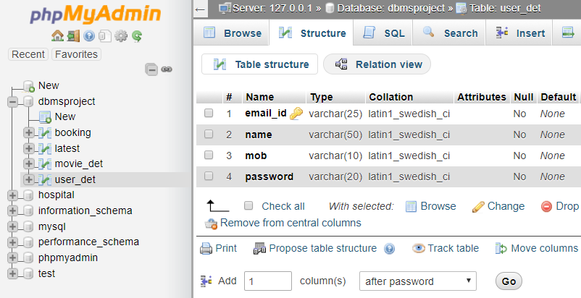
(1) user_det schema :

Slide 7
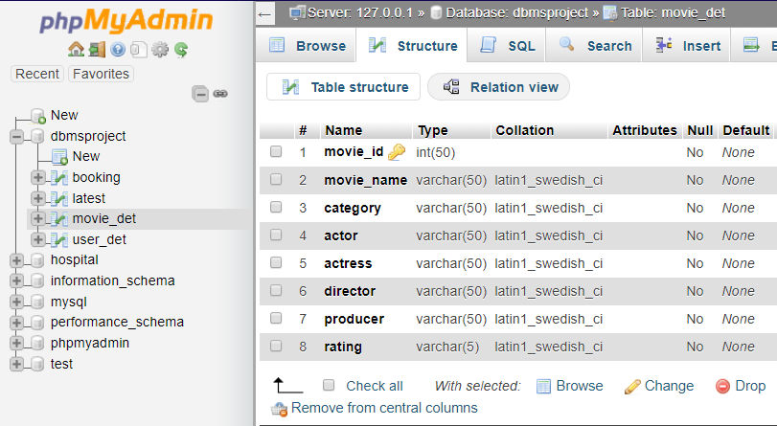
(2) movie_det schema :

Slide 8
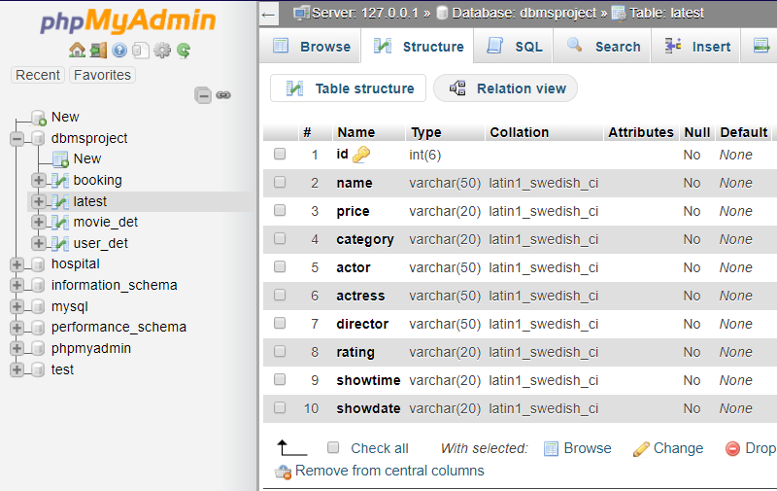
(3) latest schema :

Slide 9
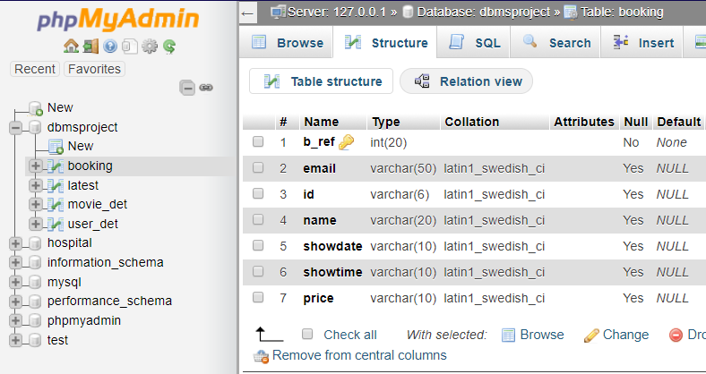
(4) booking schema :

Slide 10
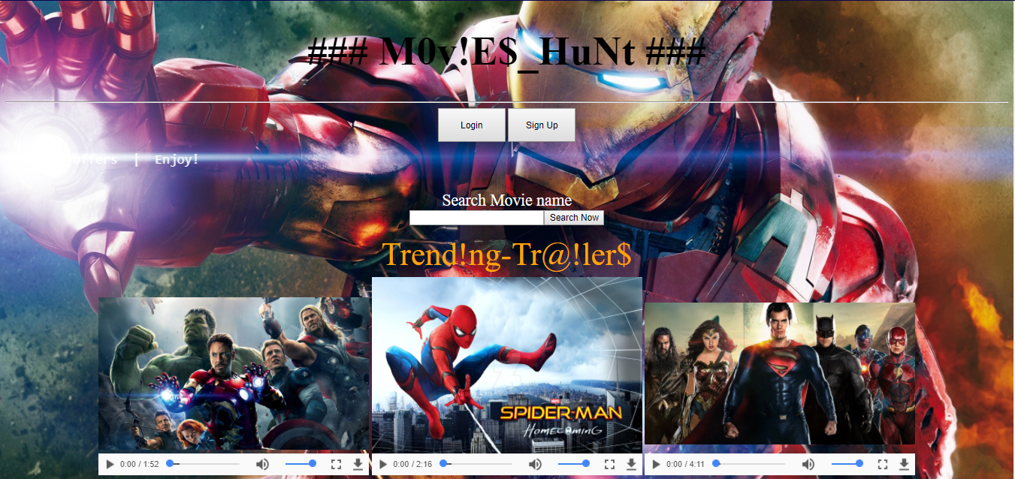
Home page: Our main page where we can signup,login and search movies.

Slide 11
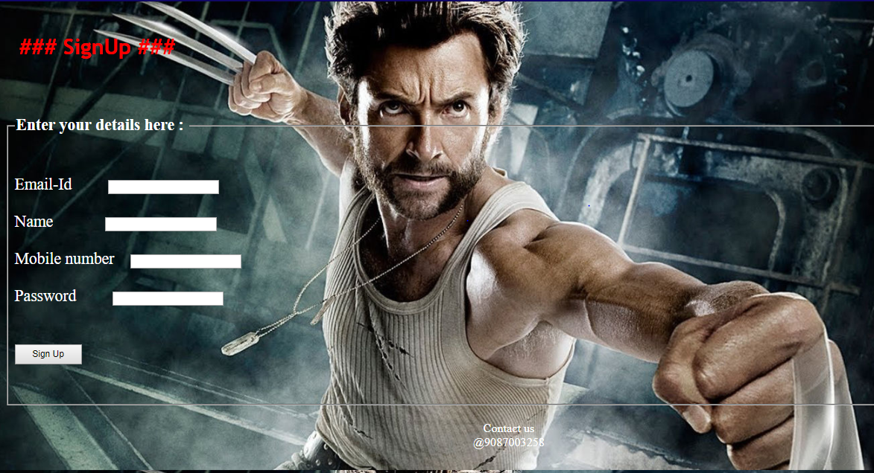
Signup page: A new user can be added here.

Slide 12
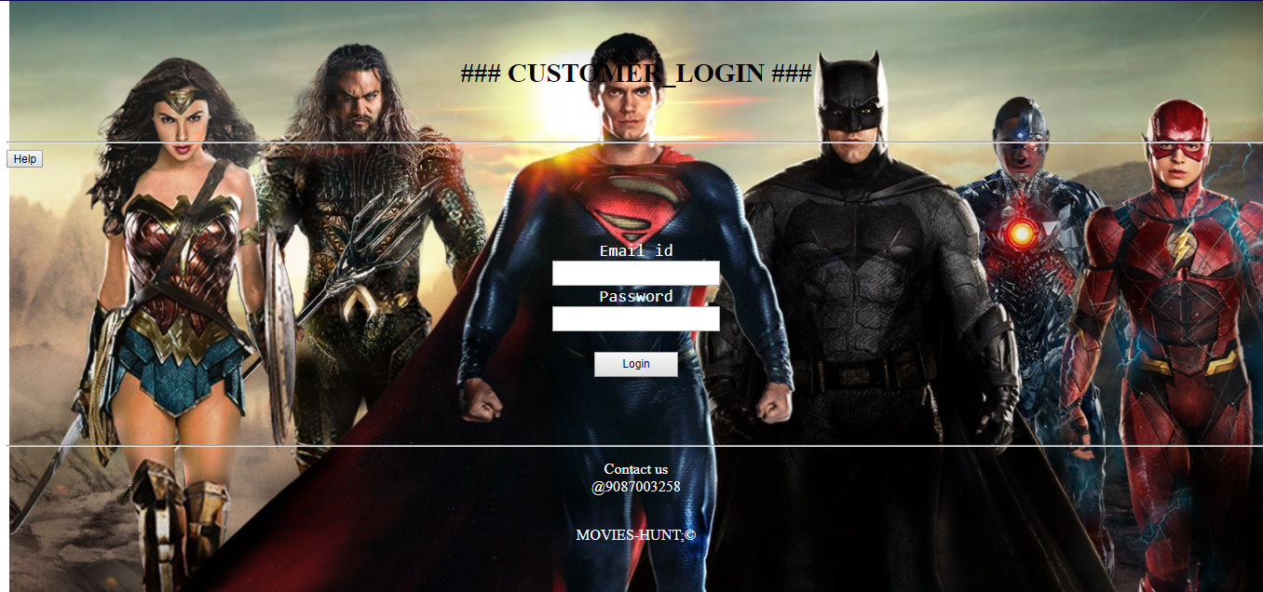
Login page: A registered user can login into his account.

Slide 13
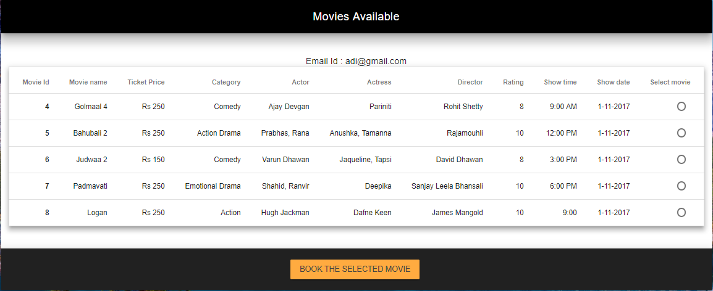
Booking table : contains list of movies available for booking

Slide 14
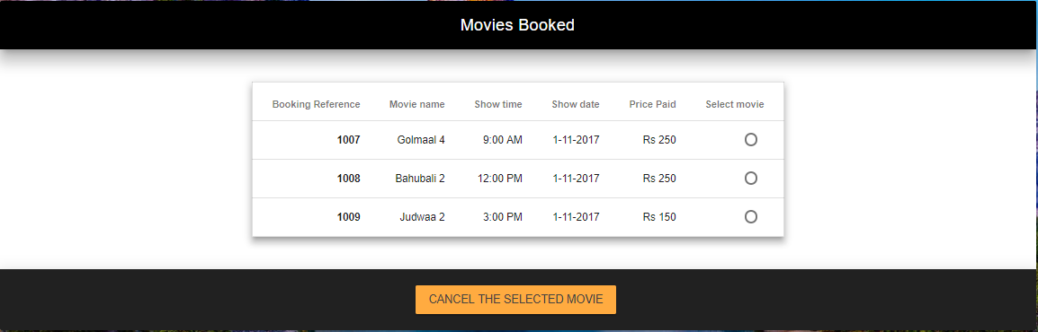
Booking details : contains list of movies booked by user

Slide 15
Thank You!

